Slide 1

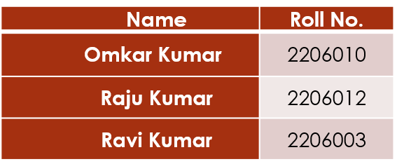
Project Report On “Dementia Detection” Project Advisor : Dr. S.K. Tripathi
Submitted By:

Slide 2
Problem Statement
Context: Alzheimer’s Disease is a progressive neurological disorder requiring early detection for effective management.
The Issue: Subtle structural changes in MRI scans (like "Very Mild" dementia) are difficult to distinguish from "Non-Demented" brains using traditional methods.
Objective: To build a robust Deep Learning model that handles class imbalance effectively and combines local feature extraction (CNN) with global context understanding (Transformers) to classify MRI scans into four stages of dementia.

Slide 3
About Dataset Used
Name : Alzheimer's MRI 4-Class Dataset
Data-type : 2D MRI Grayscale Images.
Resolution : 176*208 pixels
Classes : 4 categories
Non-Demented
Very-mild Demented
Mild Demented
Moderate Demented
Validation Strategy: 20% of the data is held out for validation, preserving the original (unbalanced) real-world distribution to ensure honest evaluation.

Slide 4
Data Preprocessing
Loading: Images are loaded in grayscale to focus on structural density rather than colour artifacts.
Stratified Split: Train/Test split (80/20) ensures all classes are present in both sets.
Handling Imbalance (Crucial Step):
The training set undergoes Oversampling to balance the minority classes.
Target: All classes in the training set are brought to a count of ~2560 images.
Augmentation: To prevent overfitting on duplicated images, the generator applies:
Rotation (8 degrees)
Zoom (5%)
Shift (Width/Height 5%).

Slide 5
Proposed Methodology
CNN (Convolutional Neural Network): For extracting local features like edges and tissue boundaries.
CBAM (Convolutional Block Attention Module): A mechanism that refines features by applying "Channel Attention" (what to look at) and "Spatial Attention" (where to look).
ViT (Vision Transformer): Captures global relationships between distant parts of the brain image.

Slide 6
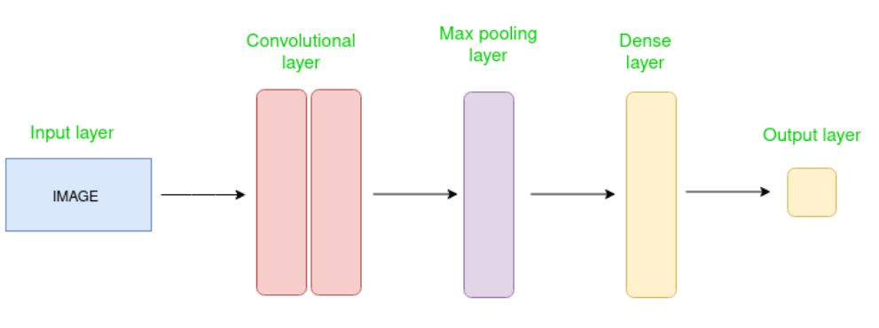
CNN Architecture
Advantages of CNNs
Good at detecting patterns and features in images, videos, and audio signals.
Robust to translation, rotation, and scaling invariance.
End-to-end training, no need for manual feature extraction.
Can handle large amounts of data and achieve high accuracy.

Slide 7
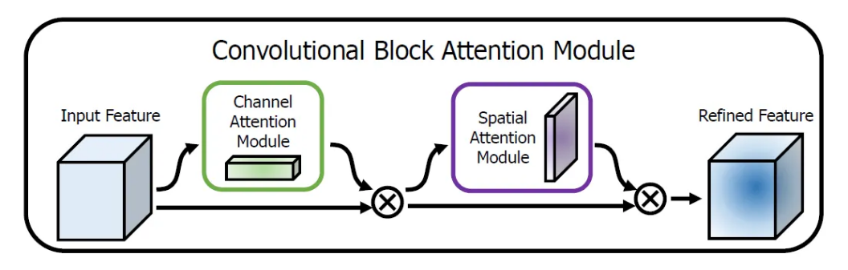
CBAM Architecture
Convolutional Block Attention Module
Given an intermediate feature map, BAM sequentially infers attention maps along two separate dimensions, channel and spatial, then the attention maps are multiplied to the input feature map for adaptive feature refinement.
CBAM can be integrated into any CNN architectures seamlessly with negligible overheads and is end-to-end trainable along with base CNNs.

Slide 8
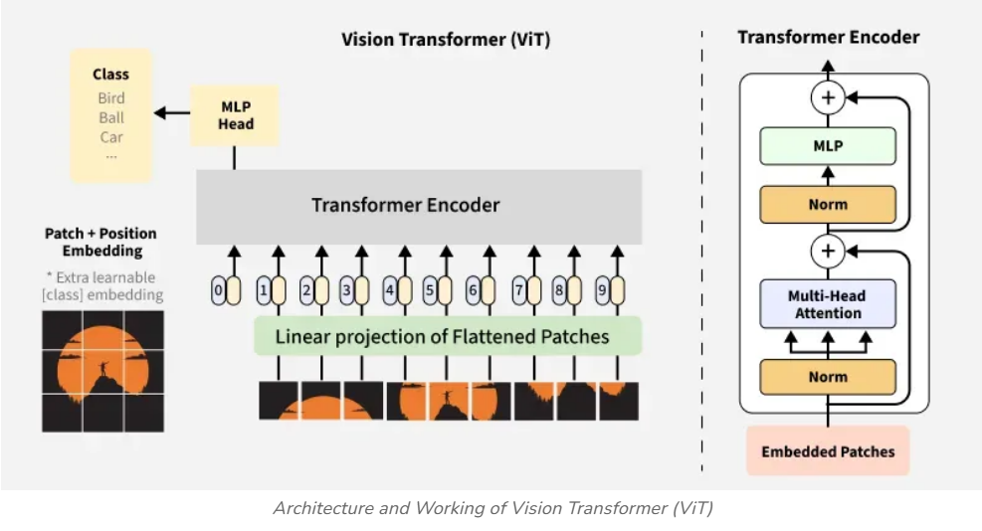
Vision Transformer
Input Image Processing: The input image is divided into patches, which are flattened and embedded using a linear projection.
Positional Encoding: Positional encodings are added to the patch embeddings to retain spatial information.
Transformer Encoder: The patch embeddings (along with the CLS token) are passed through multiple transformer encoder layers, which include multi-head self-attention and feed-forward networks.
Classification Head: The CLS token's output is extracted and fed into an MLP for final classification.

Slide 9
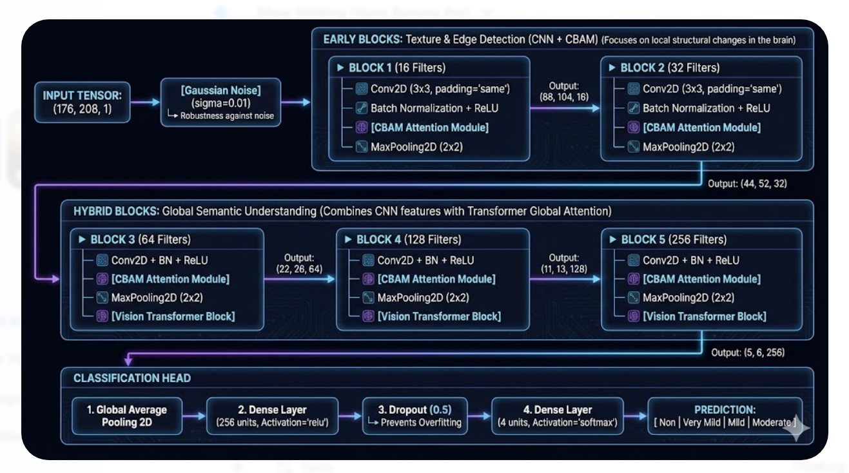
Architecture design

Slide 10
Architecture design
Based on the code and schematic:
Input: (176, 208, 1) + Gaussian Noise (for robustness).
Early Blocks (1-2):
Conv2D => Batch Normalization => ReLU Activation.
CBAM Block: Refines the feature map.
Max Pooling: Reduces dimensionality.
Deep Blocks (3-5):
Hybrid Branching:
Path A: Standard CNN layers (64, 128, 256 filters).
Path B (ViT): Image flattened into sequence => Multi-Head Attention => MLP.
Fusion: Path A and Path B are added (Residual Connection).
Classification Head: Global Average Pooling => Dense (256) => Output (4 Classes, Softmax).

Slide 11
Implementation details
Framework: TensorFlow/Keras.
Optimizer: Adam (LR = 0.0001).
Regularization: L2 Regularization (0.005) and Dropout (0.3 to 0.5) significantly used to fight overfitting on the MRI data.
Callbacks:
Reduce LR on plateau : Halves learning rate if validation loss stagnates
Early Stopping : Stops training if accuracy doesn't improve for 8 epochs.
Batch Size: 16 (tuned for stability).

Slide 12
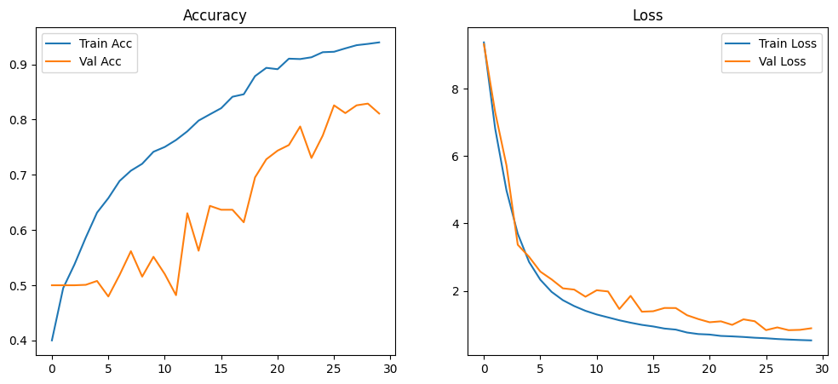
Learning Curve

Slide 13
Results
Training Dynamics:
The model learns steadily, with training accuracy reaching ~93% by epoch 30.
Validation accuracy stabilizes, showing the model generalizes well despite the complex architecture.
Final Metrics:
Final Validation Accuracy: 0.82.
Final Precision : 0.87
Final Recall : 0.80
F1-score : 0.83
Loss: ~0.88.
Class | Precision | Recall | F1-Score
Mild-demented | 0.84 | 0.75 | 0.79
Moderate | 0.85 | 0.77 | 0.81
Non-demented | 0.87 | 0.88 | 0.875
Very-Mild | 0.76 | 0.79 | 0.78

Slide 14
References
Woo et al. (2018), "CBAM: Convolution Block Attention Module "
Dosovitskiy et al. (2020), "An Image is Worth 16x16 Words: Transformers for Image Recognition at Scale“
Al-Amin et al. (2025), "Hybrid-RViT: Hybridizing ResNet-50 and Vision Transformer"

